Slide 1
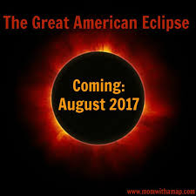
A Sign From God

Slide 2
Gen 1:14
And God said, Let there be lights in the firmament of the heaven to divide the day from the night; and let them be for signs, and for seasons, and for days, and years:
Gen 1:15
And let them be for lights in the firmament of the heaven to give light upon the earth: and it was so.
Gen 1:16
And God made two great lights; the greater light to rule the day, and the lesser light to rule the night: he made the stars also.

Slide 4
Joe 2:31
The sun shall be turned into darkness, and the moon into blood, before the great and the terrible day of the LORD come.

Slide 6
Jewish Tradition
Solar Eclipses seen as bad omens for the Gentiles

Slide 7
100 Million people will see it

Slide 8
Last time?
99 years ago, 1918
Next time?

Slide 10
1st of Elul
August 22 begins the days of Repentance right up until the Prophetic Feast of the Day of Atonement
Moses ascended Mount Sinai the second time during the month of Elul to get the second set of tablets and to pray for the sin of Israel.

Slide 11
Sins of Americans
Pornography
Sex slaves
Abortion
Murder
Unjustified mass incarceration
Greed
Adultery
Fornication
Theft

Slide 13
Repent
re·pent
verb
verb: repent; 3rd person present: repents; past tense: repented; past participle: repented; gerund or present participle: repenting
feel or express sincere regret or remorse about one's wrongdoing or sin.

Slide 14
America Celebrates Darkness
Hotels sold out
Money making events
Food vendors
Tickets being sold
Live music
Dancing
Liquor being sold
Games for kids
Workshops

Slide 15
Eclipse Parties
Parks
Bars
Zoos
Restaurants
Libraries
Parking $20.00

Slide 16
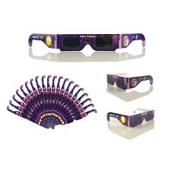
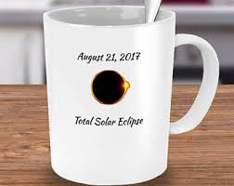
Get your eclipse souvenirs now at www.greatamericaneclipse.com/store

Slide 19
1Jo 1:5
This then is the message which we have heard of him, and declare unto you, that God is light, and in him is no darkness at all.
1Jo 1:6
If we say that we have fellowship with him, and walk in darkness, we lie, and do not the truth:
1Jo 1:7
But if we walk in the light, as he is in the light, we have fellowship one with another, and the blood of Jesus Christ his Son cleanseth us from all sin.

