Slide 1
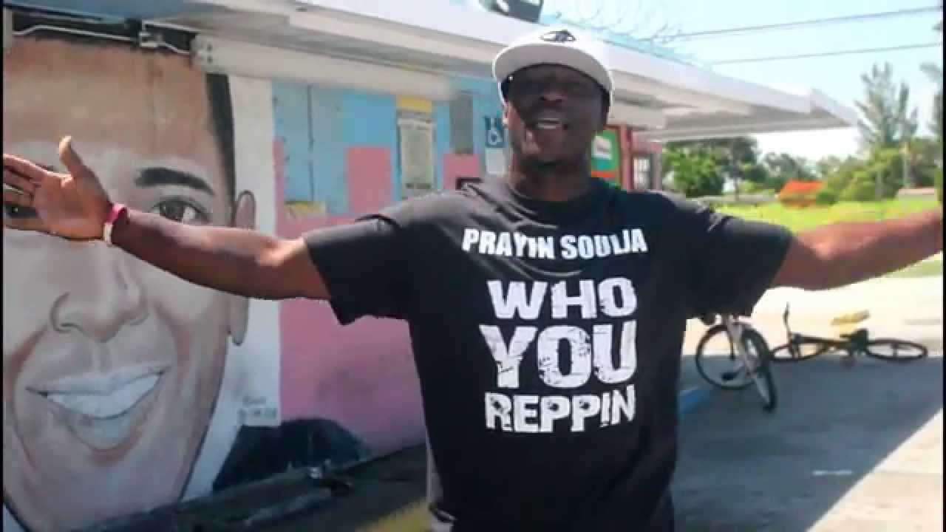

Slide 2
Jhn 12:31 - Now is the judgment of this world: now shall the prince of this world be cast out.
Jhn 12:32 - And I, if I be lifted up from the earth, will draw all men unto me.

Slide 3
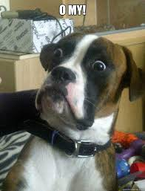
How many people on your job would be surprised to learn you are a Christian?

Slide 4
Mal 1:11 - For from the rising of the sun even unto the going down of the same my name shall be great among the Gentiles; and in every place incense shall be offered unto my name, and a pure offering: for my name shall be great among the heathen, saith the LORD of hosts.

Slide 5
What we do Rep

Slide 6
Nicki Minaj’s Barbies

Slide 7
Beyonce’s Beyhive

Slide 9
Matthew 12:34b
….. for out of the abundance of the heart the mouth speaketh.

Slide 10
Fall in love with Jesus!

Slide 11
Rom 5:8 - But God commendeth his love toward us, in that, while we were yet sinners, Christ died for us.

