Slide 1
Death, Hell & the Grave
Before the Resurrection

Slide 2
Mat 27:50
Jesus, when he had cried again with a loud voice, yielded up the ghost.
Mat 27:51
And, behold, the veil of the temple was rent in twain from the top to the bottom; and the earth did quake, and the rocks rent;

Slide 3
Mat 27:52
And the graves were opened; and many bodies of the saints which slept arose,
Mat 27:53
And came out of the graves after his resurrection, and went into the holy city, and appeared unto many.

Slide 4
Mat 28:18
And Jesus came and spake unto them, saying, All power is given unto me in heaven and in earth.

Slide 5
Eph 4:8
Wherefore he saith, When he ascended up on high, he led captivity captive, and gave gifts unto men.
Eph 4:9
(Now that he ascended, what is it but that he also descended first into the lower parts of the earth?

Slide 6
Eph 4:10
He that descended is the same also that ascended up far above all heavens, that he might fill all things.)

Slide 7
Act 2:26
Therefore did my heart rejoice, and my tongue was glad; moreover also my flesh shall rest in hope:
Act 2:27
Because thou wilt not leave my soul in hell, neither wilt thou suffer thine Holy One to see corruption.

Slide 8
1Pe 3:19
By which also he went and preached unto the spirits in prison;
1Pe 3:20
Which sometime were disobedient, when once the longsuffering of God waited in the days of Noah, while the ark was a preparing, wherein few, that is, eight souls were saved by water.

Slide 9
1Pe 3:21
The like figure whereunto even baptism doth also now save us (not the putting away of the filth of the flesh, but the answer of a good conscience toward God,) by the resurrection of Jesus Christ:
1Pe 3:22
Who is gone into heaven, and is on the right hand of God; angels and authorities and powers being made subject unto him.

Slide 10
Mat 12:40
For as Jonas was three days and three nights in the whale's belly; so shall the Son of man be three days and three nights in the heart of the earth.
Mat 12:41
The men of Nineveh shall rise in judgment with this generation, and shall condemn it: because they repented at the preaching of Jonas; and, behold, a greater than Jonas is here.

Slide 11
1Pe 4:6
For, for this cause was the gospel preached also to them that are dead, that they might be judged according to men in the flesh, but live according to God in the spirit

Slide 12
Rev 1:18
I am he that liveth, and was dead; and, behold, I am alive for evermore, Amen; and have the keys of hell and of death.

Slide 13
Rev 2:7
He that hath an ear, let him hear what the Spirit saith unto the churches; To him that overcometh will I give to eat of the tree of life, which is in the midst of the paradise of God.

Slide 14
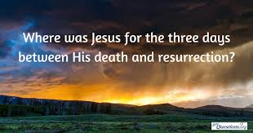

Slide 15
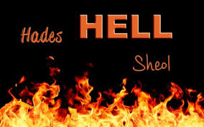

Slide 16
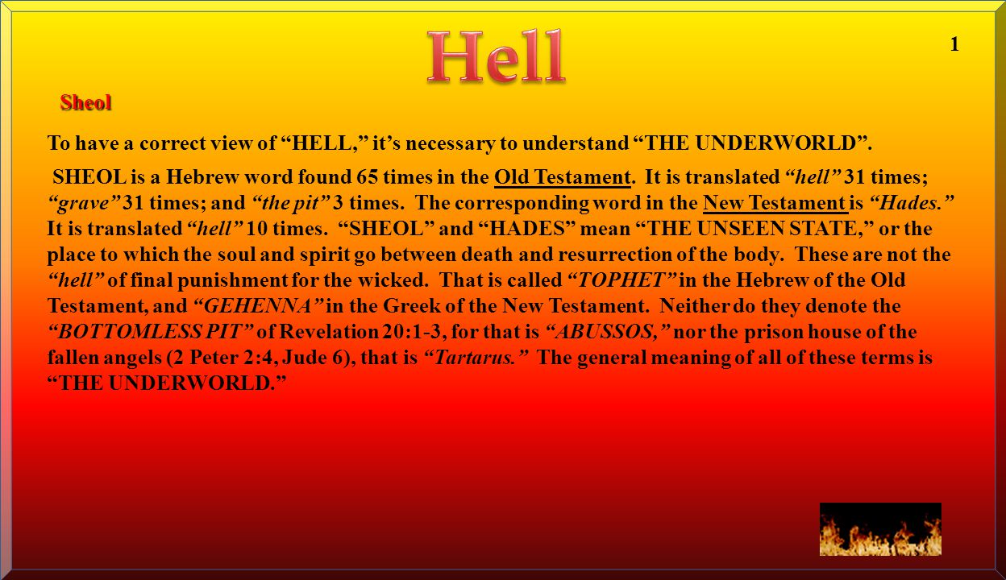

Slide 17
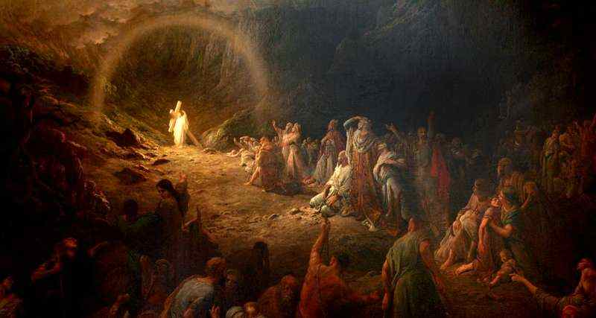

Slide 18
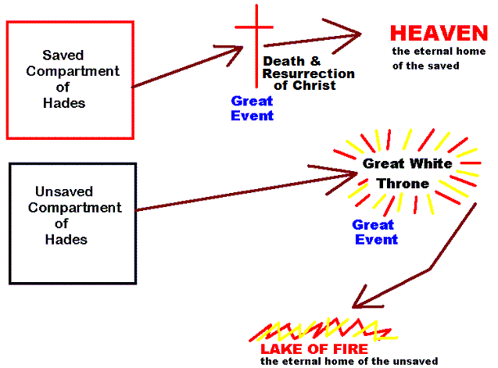
Abraham’s Bosom
Paradise
Gulf Fixed
Tartarus

Slide 19
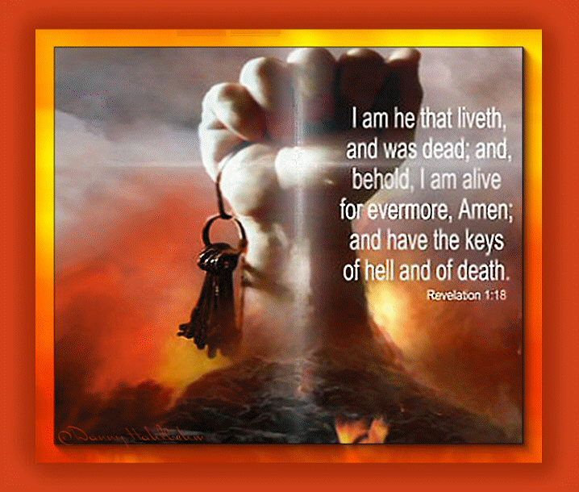

Slide 20
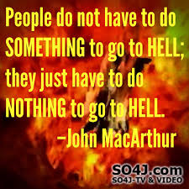

Slide 21
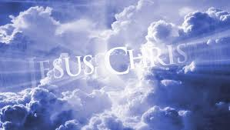

Slide 22
