Slide 1
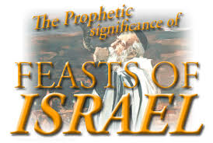

Slide 3
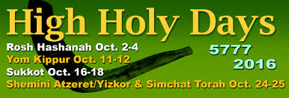

Slide 6
First 4 Feasts Fulfilled
Passover – pictures the Death of Jesus Christ
Feast of Unleavened Bread – pictures the Burial of Jesus Christ
Feast of First Fruits – pictures the Resurrection of Christ
Pentecost – pictures the Descent of the Holy Spirit & the Birth of the Church

Slide 7
Unfulfilled
Rosh Hashanah - Feast of the Trumpets – pictures the Rapture of the Church
Yom Kippur - Feast of Atonement – pictures the Second Coming of Jesus Christ
Sukkot -Feast of Tabernacles – pictures the Millennial Reign of Jesus Christ

Slide 8
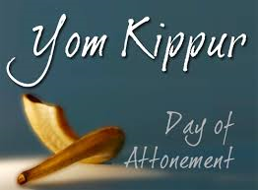
The Feast of Yom Kippur
The Day of Atonement

Slide 10
10 Tishrei
Sabbath of Sabbath’s – a strict day of rest, no work can be performed and 25 hours of fasting
Highest Holy Day – of all Jewish holidays
Marks 10 days of Awe
A day of deliverance and salvation
Most of the day is spent in prayer.

Slide 16
Prophesies
The Second Coming of Jesus Christ to the Earth
Jesus as our Kohen Godol (High Priest) after the order of Malki-Tzedek (Melchizedek)

Slide 17
Jesus – The Lamb of God
Scapegoat – ransom, redeem,
The greatest “Purim” of all!

Slide 20
Holy of Holies

Slide 27
Behold He Comes

