Slide 1
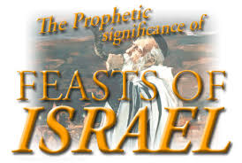

Slide 2
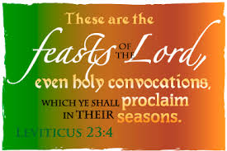

Slide 5
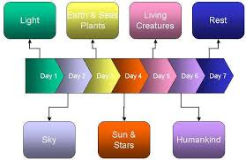

Slide 6
First 4 Feasts Fulfilled
Passover – pictures the Death of Jesus Christ
Feast of Unleavened Bread – pictures the Burial of Jesus Christ
Feast of First Fruits – pictures the Resurrection of Christ
Pentecost – pictures the Descent of the Holy Spirit & the Birth of the Church

Slide 7
Unfulfilled
Rosh Hashanah - Feast of the Trumpets – depicts the Rapture of the Church
Yom Kippur - Feast of Atonement – depicts the Judgment Seat of Christ
Sukkot - Feast of Tabernacles – depicts the eternal reign of God with His people

Slide 11
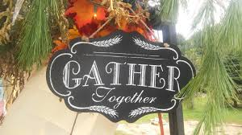

Slide 13
They were also to celebrate with the lulav (myrtle and willow branches tied together by a palm frond) and ethrog (citron, a fragrant and tasty citrus) (Leviticus 23:40), representing the fruitfulness and beauty of the Promised Land.

Slide 16
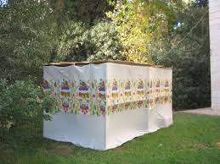

Slide 17
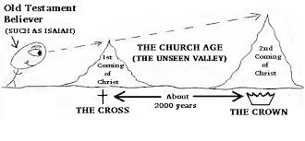

Slide 18
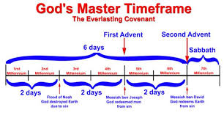

Slide 19
Rev 19:1
And after these things I heard a great voice of much people in heaven, saying, Alleluia; Salvation, and glory, and honour, and power, unto the Lord our God:
Rev 19:2
For true and righteous are his judgments: for he hath judged the great whore, which did corrupt the earth with her fornication, and hath avenged the blood of his servants at her hand.

Slide 20
Rev 19:3
And again they said, Alleluia. And her smoke rose up for ever and ever.
Rev 19:4
And the four and twenty elders and the four beasts fell down and worshipped God that sat on the throne, saying, Amen; Alleluia.
Rev 19:5
And a voice came out of the throne, saying, Praise our God, all ye his servants, and ye that fear him, both small and great.

Slide 21
Rev 19:6
And I heard as it were the voice of a great multitude, and as the voice of many waters, and as the voice of mighty thunderings, saying, Alleluia: for the Lord God omnipotent reigneth.
Rev 19:7
Let us be glad and rejoice, and give honour to him: for the marriage of the Lamb is come, and his wife hath made herself ready.
Rev 19:8
And to her was granted that she should be arrayed in fine linen, clean and white: for the fine linen is the righteousness of saints.

Slide 22
Rev 19:9
And he saith unto me, Write, Blessed are they which are called unto the marriage supper of the Lamb. And he saith unto me, These are the true sayings of God.
Rev 19:10
And I fell at his feet to worship him. And he said unto me, See thou do it not: I am thy fellowservant, and of thy brethren that have the testimony of Jesus: worship God: for the testimony of Jesus is the spirit of prophecy.
Rev 19:11
And I saw heaven opened, and behold a white horse; and he that sat upon him was called Faithful and True, and in righteousness he doth judge and make war.

Slide 23
Rev 19:12
His eyes were as a flame of fire, and on his head were many crowns; and he had a name written, that no man knew, but he himself.
Rev 19:13
And he was clothed with a vesture dipped in blood: and his name is called The Word of God.
Rev 19:14
And the armies which were in heaven followed him upon white horses, clothed in fine linen, white and clean.

Slide 24
Rev 19:15
And out of his mouth goeth a sharp sword, that with it he should smite the nations: and he shall rule them with a rod of iron: and he treadeth the winepress of the fierceness and wrath of Almighty God.
Rev 19:16
And he hath on his vesture and on his thigh a name written, KING OF KINGS, AND LORD OF LORDS.
Rev 19:17
And I saw an angel standing in the sun; and he cried with a loud voice, saying to all the fowls that fly in the midst of heaven, Come and gather yourselves together unto the supper of the great God;

Slide 25
Rev 19:18
That ye may eat the flesh of kings, and the flesh of captains, and the flesh of mighty men, and the flesh of horses, and of them that sit on them, and the flesh of all men, both free and bond, both small and great.
Rev 19:19
And I saw the beast, and the kings of the earth, and their armies, gathered together to make war against him that sat on the horse, and against his army.
Rev 19:20
And the beast was taken, and with him the false prophet that wrought miracles before him, with which he deceived them that had received the mark of the beast, and them that worshipped his image. These both were cast alive into a lake of fire burning with brimstone.
Rev 19:21
And the remnant were slain with the sword of him that sat upon the horse, which sword proceeded out of his mouth: and all the fowls were filled with their flesh.

Slide 26
Rev 20:1
And I saw an angel come down from heaven, having the key of the bottomless pit and a great chain in his hand.
Rev 20:2
And he laid hold on the dragon, that old serpent, which is the Devil, and Satan, and bound him a thousand years,
Rev 20:3
And cast him into the bottomless pit, and shut him up, and set a seal upon him, that he should deceive the nations no more, till the thousand years should be fulfilled: and after that he must be loosed a little season.

Slide 27
Rev 20:4
And I saw thrones, and they sat upon them, and judgment was given unto them: and I saw the souls of them that were beheaded for the witness of Jesus, and for the word of God, and which had not worshipped the beast, neither his image, neither had received his mark upon their foreheads, or in their hands; and they lived and reigned with Christ a thousand years.
Rev 20:5
But the rest of the dead lived not again until the thousand years were finished. This is the first resurrection.

Slide 28
Rev 20:6
Blessed and holy is he that hath part in the first resurrection: on such the second death hath no power, but they shall be priests of God and of Christ, and shall reign with him a thousand years.
Rev 20:7
And when the thousand years are expired, Satan shall be loosed out of his prison,
Rev 20:8
And shall go out to deceive the nations which are in the four quarters of the earth, Gog and Magog, to gather them together to battle: the number of whom is as the sand of the sea.

Slide 29
Rev 20:9
And they went up on the breadth of the earth, and compassed the camp of the saints about, and the beloved city: and fire came down from God out of heaven, and devoured them.
Rev 20:10
And the devil that deceived them was cast into the lake of fire and brimstone, where the beast and the false prophet are, and shall be tormented day and night for ever and ever.
Rev 20:11
And I saw a great white throne, and him that sat on it, from whose face the earth and the heaven fled away; and there was found no place for them.

Slide 30
Rev 20:12
And I saw the dead, small and great, stand before God; and the books were opened: and another book was opened, which is the book of life: and the dead were judged out of those things which were written in the books, according to their works.
Rev 20:13
And the sea gave up the dead which were in it; and death and hell delivered up the dead which were in them: and they were judged every man according to their works.
Rev 20:14
And death and hell were cast into the lake of fire. This is the second death.
Rev 20:15
And whosoever was not found written in the book of life was cast into the lake of fire.

Slide 31
Rev 21:1
And I saw a new heaven and a new earth: for the first heaven and the first earth were passed away; and there was no more sea.
Rev 21:2
And I John saw the holy city, new Jerusalem, coming down from God out of heaven, prepared as a bride adorned for her husband.
Rev 21:3
And I heard a great voice out of heaven saying, Behold, the tabernacle of God is with men, and he will dwell with them, and they shall be his people, and God himself shall be with them, and be their God.

Slide 32
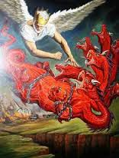

Slide 34
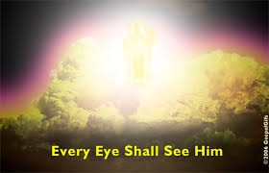

Slide 35
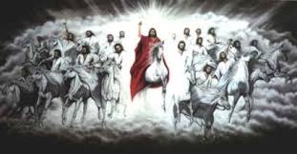

Slide 36
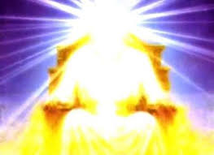

Slide 37
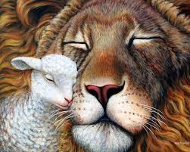

Slide 38
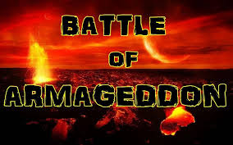

Slide 39
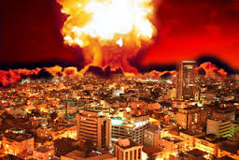

Slide 40
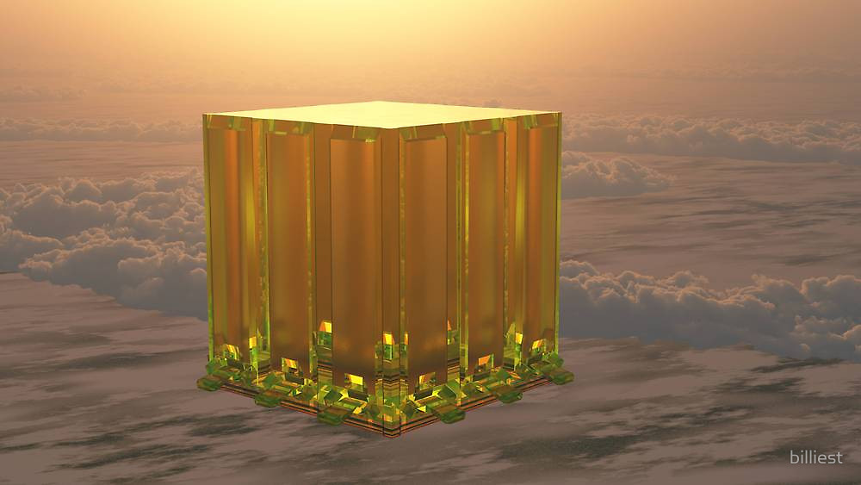
The New Jerusalem

Slide 41
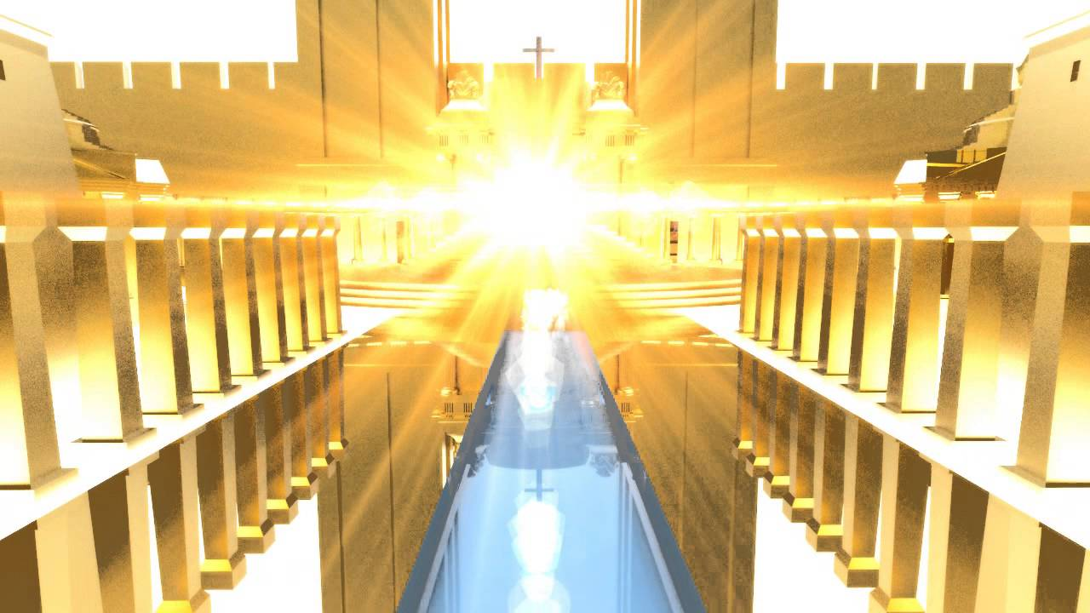

Slide 42
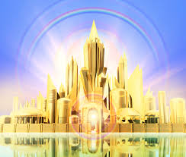

Slide 43
From Rosh Hashanah to Sukkot
Tribulation
Whore of Babylon Destroyed
Rapture of the Church
Wedding & Wedding Supper of the Lamb
Coronation & Crowning of the King
Crowning of the Believers
Jesus Returns to Make War
Wrath of God Poured Out
Beast & False Prophet Taken To the Lake of Fire
Devil Cast into the Bottomless Pit
Millennial Reign of Christ with the Tribulation Saints
Satan loosed for a short time
Battle of Armageddon
Satan Cast Into the Lake of Fire
Atonement Service
Books Opened
Judgment Seat of Christ – Heaven and Earth flee away
Dead Judged
Death, Hell and those not in the Book of Life Cast into the Lake of Fire
New Heaven & New Earth
New Jerusalem
God Tabernacled with Men

Slide 44
