Slide 1
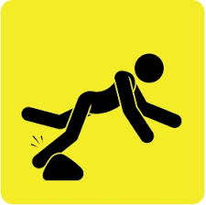
Tripping over the Rock

Slide 2
1Pe 2:6 - For in Scripture it says: “See, I lay a stone in Zion, a chosen and precious cornerstone, and the one who trusts in him will never be put to shame.” (Isaiah 28:16)
1Pe 2:7 - Now to you who believe, this stone is precious. But to those who do not believe, “The stone the builders rejected has become the cornerstone,”
1Pe 2:8 - and, “A stone that causes people to stumble and a rock that makes them fall.” They stumble because they disobey the message—which is also what they were destined for.

Slide 3
Cornerstone
“The cornerstone (or foundation stone or setting stone) is the first stone set in the construction of a masonry foundation, important since all other stones will be set in reference to this stone, thus determining the position of the entire structure”. (Wikipedia)

Slide 8
Stumbling Block
a circumstance that causes difficulty or hesitation.
Synonyms: hurdle, obstacle, barrier, hindrance, impediment
“The stumbling block of 1 Corinthians 8 (and Romans 14) is an action, taken by a biblically informed believer, that does not in itself violate any scriptural precept or principle, but which a less knowledgeable or less mature believer might imitate, in a way that violates his conscience”. (Alcorn, 2000)

