Slide 1
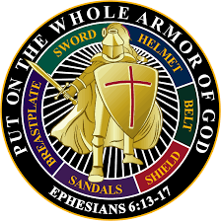
Put on the whole armor

Slide 3
Eph 6:10
Finally, my brethren, be strong in the Lord, and in the power of his might.
Eph 6:11
Put on the whole armour of God, that ye may be able to stand against the wiles of the devil.
Eph 6:12
For we wrestle not against flesh and blood, but against principalities, against powers, against the rulers of the darkness of this world, against spiritual wickedness in high places.

Slide 4
Eph 6:13
Wherefore take unto you the whole armour of God, that ye may be able to withstand in the evil day, and having done all, to stand.
Eph 6:14
Stand therefore, having your loins girt about with truth, and having on the breastplate of righteousness;
Eph 6:15
And your feet shod with the preparation of the gospel of peace;

Slide 5
Eph 6:16
Above all, taking the shield of faith, wherewith ye shall be able to quench all the fiery darts of the wicked.
Eph 6:17
And take the helmet of salvation, and the sword of the Spirit, which is the word of God:
Eph 6:18
Praying always with all prayer and supplication in the Spirit, and watching thereunto with all perseverance and supplication for all saints;

